Slide 1
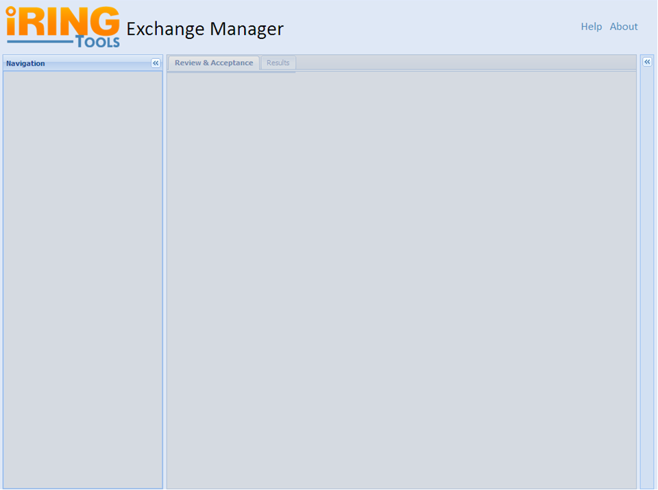
IRINGTOOLS-8: Basic Layout
Notes:
Sub Tasks:
Package ExchangeManager for Deployment.
Deploy ExchangeManager Package and Verify on Test Server.

Slide 2

IRINGTOOLS-1: About Screen
Version #
Exchange Manager Short Description
  What is Exchange Manager
  Mention and Link to WSO₂
  Licensing Information (Link:BSD3)
Link: iRING User Group
This should be more of a mock up of the actual Screen.
Notes:
Links:
WSO2: http://wso2.com/products/enterprise-service-bus/
BSD3: http://www.opensource.org/licenses/bsd-license.php
iRINGUG: http://iringug.org/wiki/index.php?title=ExchangeManager
Help Link will goto: http://iringug.org/wiki/index.php?title=ESBUsersGuide

Slide 3
IRINGTOOLS-6: Directory Resource
ESBServices will temporarily provide a Directory Resource.
Example Base Uri (will be configurable in PHP): http://localhost:8080/iringtools/directoryservice
Relative Uri: /directory
Method: GET
Notes:
Sub Tasks:
Adjust exsiting prototype Directory class per team discussion.
Package ESBServices for Deployment.
Deploy ESBServices Package and Verify on Test Server.
Sample Directory XML:
http://iring-tools.googlecode.com/svn/trunk/iRINGTools.ESB/documents/directory.xml

Slide 4
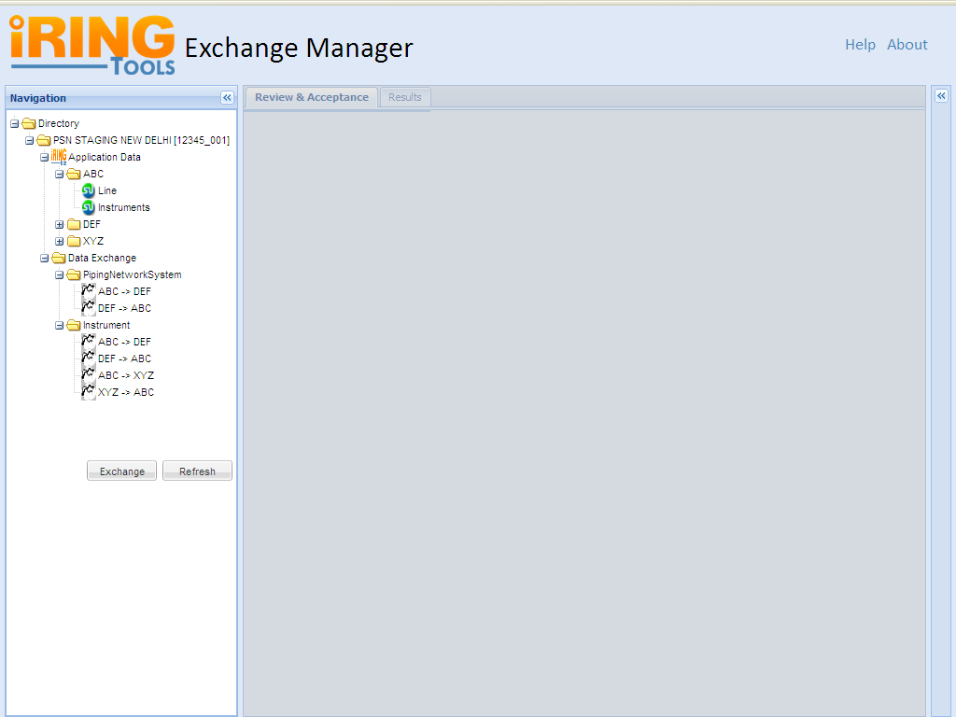
IRINGTOOLS-14: Directory Layout
Default View for a Project
Notes:
: : : Directory Panel : : :
This Panel will show a tree view of all Exchanges coming under the Project Name.
Assumptions: Exchange Manager Knows the Project Name & the Navigation Panel is responsible for display of all Applications & their exchanges.
To get the details of these Exchanges we will consume the web service from the PHP Application. After getting the XML Response we will use PHP to generate the View.
: : : Functionality : : :
+++++++++++++
Q: Default view of this Page?
Ans:
Navigation Panel expanded with Directory Listing Collapsed
Disabled Center Panel with tabs:Review & Acceptance & Results
Property Grid Collapsed
Active Help & About Links
Q: What a user can do when lands on this page?
Ans:
A User can traverse the tree to know about the applications associated with this project.
Can view the graphs under each applications and their properties.
When user will click on any application node/graph node/commodity node/exchange node the Property Grid will be updated with corresponding information with Grid View & will expand.
Q: How the user will able to Exchange the Data?
Ans: User have to select the Exchange Name first then click on the Exchange Button.
Q: What will happen as soon as a user clicks on the Exchange Button?
Ans: Will show a dialog box with Yes & No option. Please Refer the Slide # 3.
Q. What will happen when the user will click on the “Yes” Button?
Ans:
PHP application will send the request to web service for DXI information associated with this ExchangeID.
Will activate the Center Panel [Now the user have Active Review & Acceptance Tab with Result Tab]
Please Refer the Slide # 3.
Q. What will happen when the user will click on the “No” Button?
The Result Tab on Center Panel will be activated and the user can see the Progress Reports.
Review & Acceptance tab will remain disabled.
Tasks: Directory Listing
Subtasks: Technology Man days
=================================================
1. Request for Web service [PHP] 1.5*
2. Handling the Response from WS [PHP] 0.5
3. Converting the XML response to [PHP] 1.5
appropriate JSON format required to display the Tree.
4. Display the Property Grid on right side [ExtJS] 1
4. Interface creation [ExtJS] 2
5. Help & About Pages [HTML + ExtJs] 2.5
6. Test Cases & Unit Testing 2.5
============================================================
[Estimation for From Slide 1 to Slide-7] 12.5 Days
* Web Service URL will be provided. [something like where we can pass the scopeid/projectid]
Directory
Scope:12345_000
Application Data
Application:ABC
Graph:Lines
...
Graph:Instruments
...
Application:DEF
Graph:Lines
...
DataExchanges
DataExchange:12345_000.ABC.Lines -> 54321_000.ABC.Lines
...
DataExchange:12345_000.ABC.Instruments -> 12345_000.DEF.Insturments
...
Scope:54321_000
Application Data
Application:ABC
Graph:Lines
...
DataExchanges
DataExchange:12345_000.ABC.Lines -> 54321_000.ABC.Lines
...

Slide 5
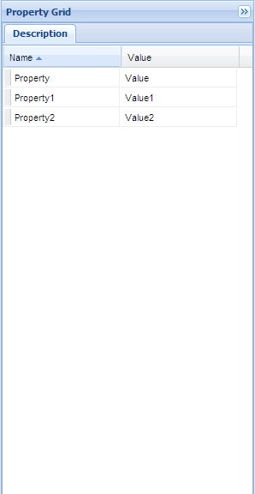
IRINGTOOLS-14: Property Grid
As soon as clicked on exchange the grid will updated
User Clicks on an Exchange
Notes:
: : : Property Grid: : :
This Grid Panel will populated with corresponding data as soon as a user clicks on the exchange name on Navigation Panel.
Question?
From where we will get these information to display on grid.
Answer: These information will available in the directory.xml file only [Hanh will send us the structure]

Slide 6
DTI Request
To get the content like dti.xml we will send ws request with
@path params: exhangeID
Example Base Uri (will be configurable): http://localhost:8080/iringtools/diffservice
Relative Uri: /{scope}/exchanges/{exchangeid}/index
Method: GET

Slide 7
DTO Request
To get the content like dto.xml we will send ws-request with
@path params:exchangeID
@request params: dti (subset or entire dti from request #2)
Example: http://localhost:8080/iringtools/diffservice
/{scope}/exchanges/{exchangeID}
Method: POST

Slide 8
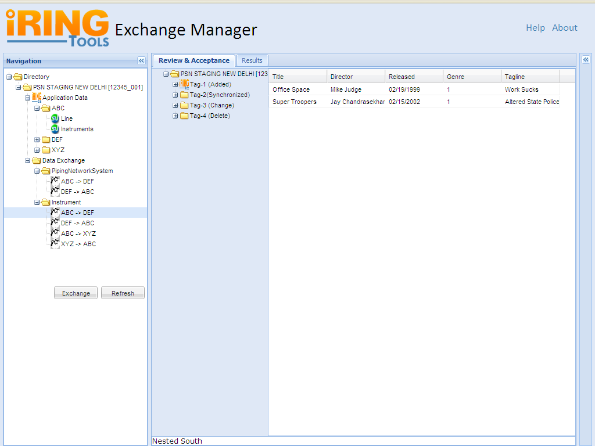
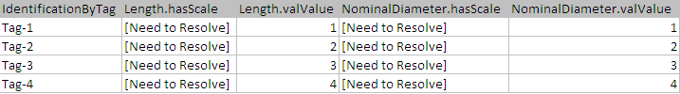
IRINGTOOLS-17: Review & Acceptance Panel
Notes:
: : : Review & Acceptance Panel : : :
This Panel will show a tree view of all identifiers for the Exchange selected.
Assumptions: Exchange Manager Knows the exchangeID whose DTI info to be fetched from the web service.
First the Web Service will respond the DTI info and our Exchange Manager App will convert into appropriate format so that it can send another Web service request to get the DTO information of these set of identifiers. We have all information related to the 1st set of identifiers with us and we will able to generate the Tree & Pagination.
Default view of this Page:
- Navigation Panel expanded
- Expanded Review & Acceptance Tree Panel along with 1st 20 identifiers list
- Paging at the bottom of Tree
- Expanded Review & Acceptance Grid Panel along with the list of properties of first tag
- Property Grid Collapsed
: : : Functionality : : :
+++++++++++++
Tasks: Review & Acceptance
Subtasks: Technology Man Days
=================================================
1. Class design to handle web service [PHP] 3
2. Class design to marshal the xml & convert to JSON [PHP] 4
3. Class design for Pagination [PHP] 2
4. Class design for Caching [PHP, MemCache] 4
5. Functionality to send the data to destination appl. [PHP] 2
6. Search/Filter functionality [EXTJS, PHP] YTD
7. JS functionalities to populate the data in grid view [JS, ExtJS] 3
8. Test cases & unit testing 4
10. Release script & uploading 1
============================================================
[Estimation for From Slide-8 to Slide-13] 23 Days
* Web Service URL will be provided. [something like where we can pass the exchangeID]
* Web Service URL will be provided. [something like where we can pass the list of tags]

Slide 9
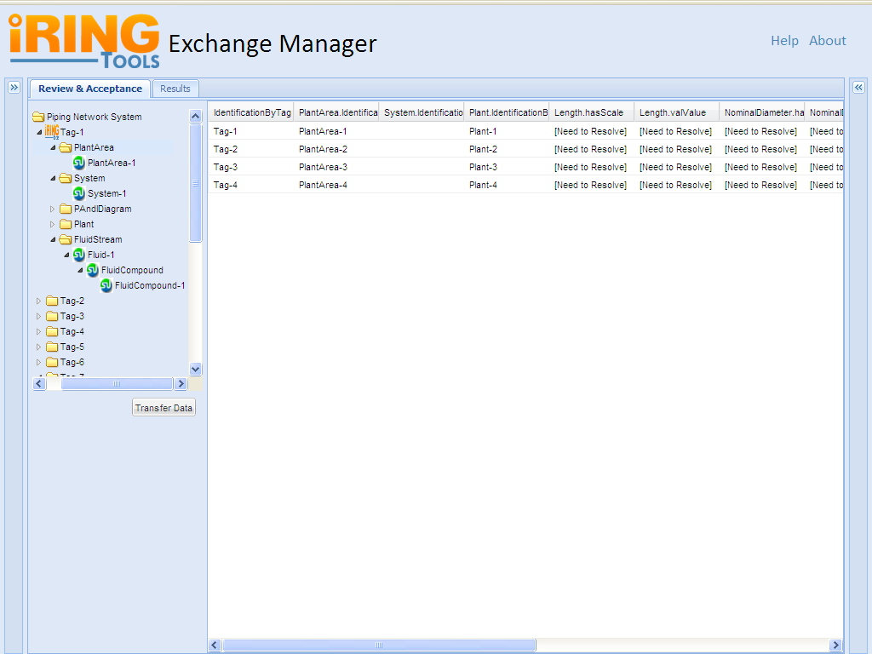
IRINGTOOLS-18 : Tree Generation
As soon as the user will select the nodes the corresponding property for that node will be populated within a grid view
Notes:
Default view:
- Review & Acceptance Tree Listing would be in form of expanded as first level
(Display only Identifier Tags i.e. Tag-1, Tag-2)
- Paging on the bottom of the Tree.
Functionality :
- Display Tree with the combination of DTO and DTI
- A User can traverse the tree to know about properties or values associated with each identifier.
- On Click a Identifier node can be expand upto three level.
- The Grid View would be populated on click of any Tree Node.

Slide 10
As soon as the user will select the nodes the corresponding property for that node will be populated within a grid view
User wants to Transfer the Data after Review & Acceptance

Slide 11
Exchange Submittal
To submit dxo to adapter service
@path params:scope, exchangeId
@request params:dto
Example: http://localhost:8080/iringtools/diffservice
/{scope}/exchanges/{exchangeId}
Method: POST

Slide 12

Results Tab

Slide 13
Step 4:
Exchange Manager will convert this XML response to appropriate tree view
Step 1:
Exchange Manager will send restful request to Web Service Provider with projectid as parameter like
*http://ws_provider_url/scope/id
Exchange Manager
Web Service Provider
Step 3:
Will provide the XML response to Exchange Manger
Client
Step 2:
Will fetch the projects detail by matching the projectid

Slide 14
Request: http://ws_provider_url/scope/id
XML response looks like similar to directory.xml file as follows:
<?xml version="1.0" encoding="UTF-8" standalone="yes"?>
<directory xmlns="http://iringtools.org/exchange/library/directory">
<project name="PSN STAGING NEW DELHI" id="12345_000">
<applicationData>
<application description="Test Application ABC" scope="12345_000" name="ABC">
<graph commodity="PipingNetworkSystem" name="Lines" />
<graph commodity="Instrument" name="Instruments" />
</application>
<application description="Test Application DEF" scope="12345_000" name="DEF">
<graph commodity="PipingNetworkSystem" name="LinesGraph" />
<graph commodity="Instrument" name="InstrumentsGraph" />
</application>
<application description="Test Application XYZ" scope="12345_001" name="XYZ">
<graph commodity="Instrument" name="InstrumentsGraph" />
</application>
</applicationData>
<dataExchanges>
<commodity name="PipingNetworkSystem">
<exchange id="1" name="ABC -&gt; DEF" />
<exchange id="2" name="DEF -&gt; ABC" />
</commodity>
<commodity name="Instrument">
<exchange id="3" name="ABC -&gt; DEF" />
<exchange id="4" name="DEF -&gt; ABC" />
<exchange id="5" name="XYZ -&gt; ABC" />
<exchange id="6" name="ABC -&gt; XYZ" />
</commodity>
</dataExchanges>
</project>
</directory>

Slide 15
Web Service Provider
Will provide the XML response:
Exchange Manager
Will convert the XML to JSON for Tree view Generation
Output will look like
Client
Notes:
<!-- PROJECT NAME MISSING-->

Slide 16
User Wants to exchange the Data
Double click on Exchange Name
Dialog Box for Review before Exchange with options Yes/No
Yes
Yes/No
No
User can traverse the Tree generated under Review & Acceptance Tab.
Can see the details of each Tags.
Select the Exchange Button under R&A Panel & the Data will transfer to the Destination Application.
Can see the Status Under Result Tab
Data will transfer from the Source >> Destination application directly
R&A Tab will remain disabled
Can see the Status Under Result Tab
Refer slide No -9
Refer slide No - **

Slide 17
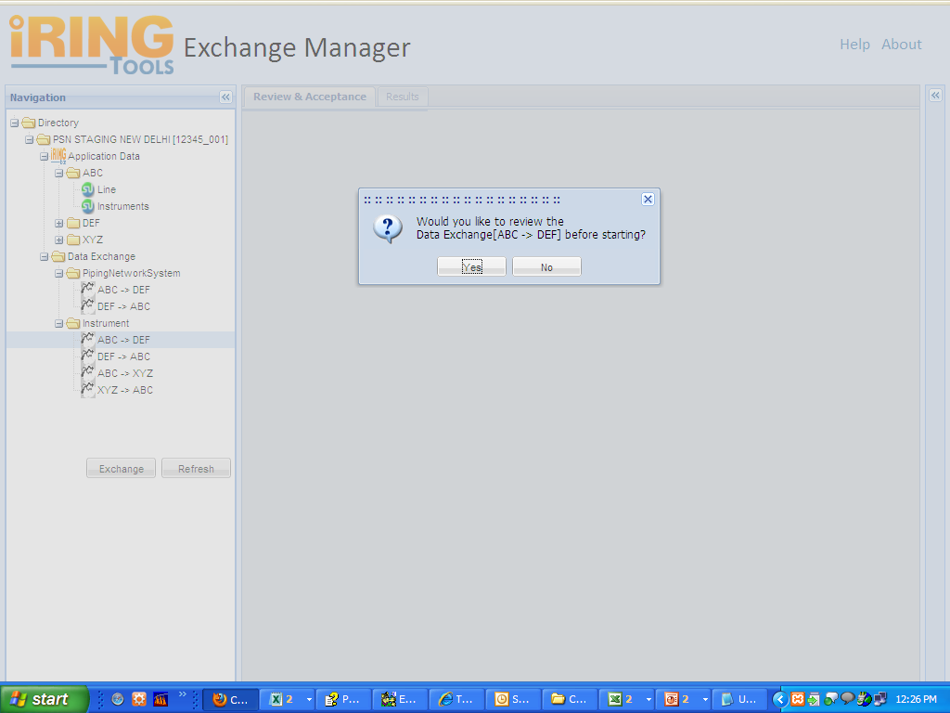
IRINGTOOLS-16: Dialog Box
User Clicked on Yes
User double clicked on an Exchange Name like ABC >> DEF
Notes:
Display dialog box on
- Double click to Exchange Name OR
- Click to Exchange Button
Functionalities :
- Ask for Review before Exchange with options Yes/No
- In case of “Yes” : Under Review & Acceptance Tab Tree and Grid will be generated
- In case of “No” : Data will transfer from the Source >> Destination application directly and display the Status Under Result Tab

Slide 18
User Clicked on Yes
Step-5
Will generate the Tree & Pagination with default grid view for Review & Acceptance tab
Client
Exchange Manager
Step-1
Request for DXI Info with exchangeID
Step-3
Will send request for DXO information for the 1st 20 identifiers
Step-4
Will return XML response for DXO related to those identifiers
Step-2
Will return the XML response for DXI related to that exchangeID
Web Service Provider

Slide 19
User Clicked on Yes
Step-5
Will generate the Tree & Pagination & default grid view for Review & Acceptance tab
Client
Exchange Manager
Step-1
*http://ws_provider_url/exchnage/id
Step-3
*http://ws_provider_url/getDXO/taglists
Step-2 [DXI XML]
<?xml version="1.0" encoding="UTF-8" standalone="yes"?>
<dataTransferIndices xmlns="http://iringtools.org/adapter/library/dto">
<dataTransferIndex>
<identifier>Tag-1</identifier>
<hashValue>7CCF26882D79E26686FAAC9F8E7862</hashValue>
<transferType>Change</transferType>
</dataTransferIndex>
<dataTransferIndex>
<identifier>Tag-2</identifier>
<hashValue>D43A1DB51F7B1150A3171DCC97C114</hashValue>
<transferType>Change</transferType>
</dataTransferIndex>
<dataTransferIndex>
<identifier>Tag-3</identifier>
<hashValue>FA36780CACAEE4E815C8E22B371312</hashValue>
<transferType>Change</transferType>
</dataTransferIndex>
</dataTransferIndices>
Step-4
Will return XML response for DXO related to those identifiers
Web Service Provider

Slide 20
Exchange Manager
Step-1
Request for Data Transfer
Web Service Provider

